Slide 1
Module 3

Slide 2
Contents
Loading Data into R
Loading a csv file
Using readr to load data

Slide 3
Loading Data into R
R, along with tidyverse, include a number of functions that can read external data files from a wide variety of sources such as csv, txt, html, and json, relational databases, and web services.
External text files need to have a specific format with the first line, called the header, containing the column names.
Each additional line in the file will have values for each variable.
The read.table() function can be used to read various file formats into a data frame.

Slide 4
Loading Data into R
The syntax for read.table()is to accept a filename, which will be the path and file name,
Along with a TRUE|FALSE indicator for the header. If set to TRUE the assumption is that column names are in the header line of the file.
Default values will be used for the column headers if these are not provided.
The path is not necessary if you have already set the working directory.
The output of the read.table() function is a data frame object.
The file. choose()function can also be use to interactively select the file

Slide 5
Loading Data into R
df = read.table(“StudyArea.csv”, header = TRUE)
Error message was generated because read_ table() function uses spaces as the delimiter between records and our file uses commas as the delimiter.
Adding separator as comma df = read.table(“StudyArea.csv”, sep=”,”, header = TRUE)
This time error due to missing values in some columns
This time adding fill=TRUE
df = read.table("StudyArea.csv", header=TRUE, fill=TRUE, sep=",")
See Environment tab, it loaded 153,095 records but there are over 4lakhs.

Slide 6
Loading Data into R
Reason: Quotes (single or double) in a csv file can cause records not to be loaded.
Let’s add one more parameter to handle records that were thrown out due to quotes. df <- read.table("StudyArea.csv", header=TRUE, fill=TRUE, quote="", sep=",") Conclusion: read.table is complex

Slide 7
Exercise 2: Loading a csv file with read.csv()
The read.csv() function is almost identical to read. table(), however the header and fill arguments are set to TRUE by default.
df = read.csv(“StudyArea.csv”)
Conclusion: read.csv() is easy

Slide 8
Exercise 2: Loading a csv file with read.table()
The read.csv() function is almost identical to read. table(), however the header and fill arguments are set to TRUE by default.
df = read.csv(“StudyArea.csv”)
Conclusion: read.csv() is easy

Slide 9
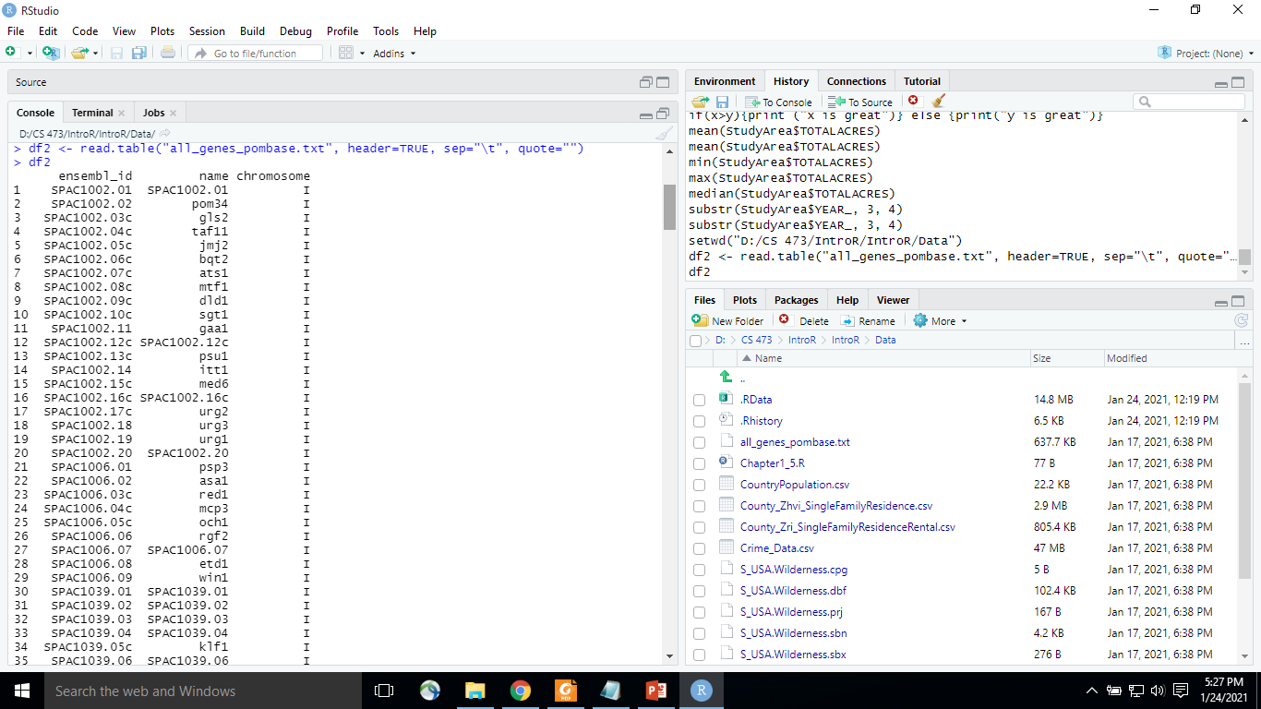
Exercise 3: Loading a tab delimited file with read.table()
The read.table() function is most often used to read the contents of a tab delimited file
df2 <- read.table("all_genes_pombase.txt", header=TRUE, sep="\t", quote="")

Slide 10
Exercise 4: Using readr to load data
The tidyverse package includes a sub-package called readr that can also be used to load external data.
The readr package includes a read_csv() function that loads data much faster(X10) than the internal read.csv() function.
Other functions of readr are read_delim(), read_csv2(), and read_tsv().
dfReadr <- read_csv("StudyArea.csv", col_types = cols(.default = "c"), col_names = TRUE)
The col_types argument was used to load all the columns as a character data type for simplification purposes.
Otherwise some additional preprocessing of the data was required
Note: read_csv for data where commas used as separator and periods for decimal
read_csv2 for data where semicolons are used for separator and commas used for decimals

Slide 11
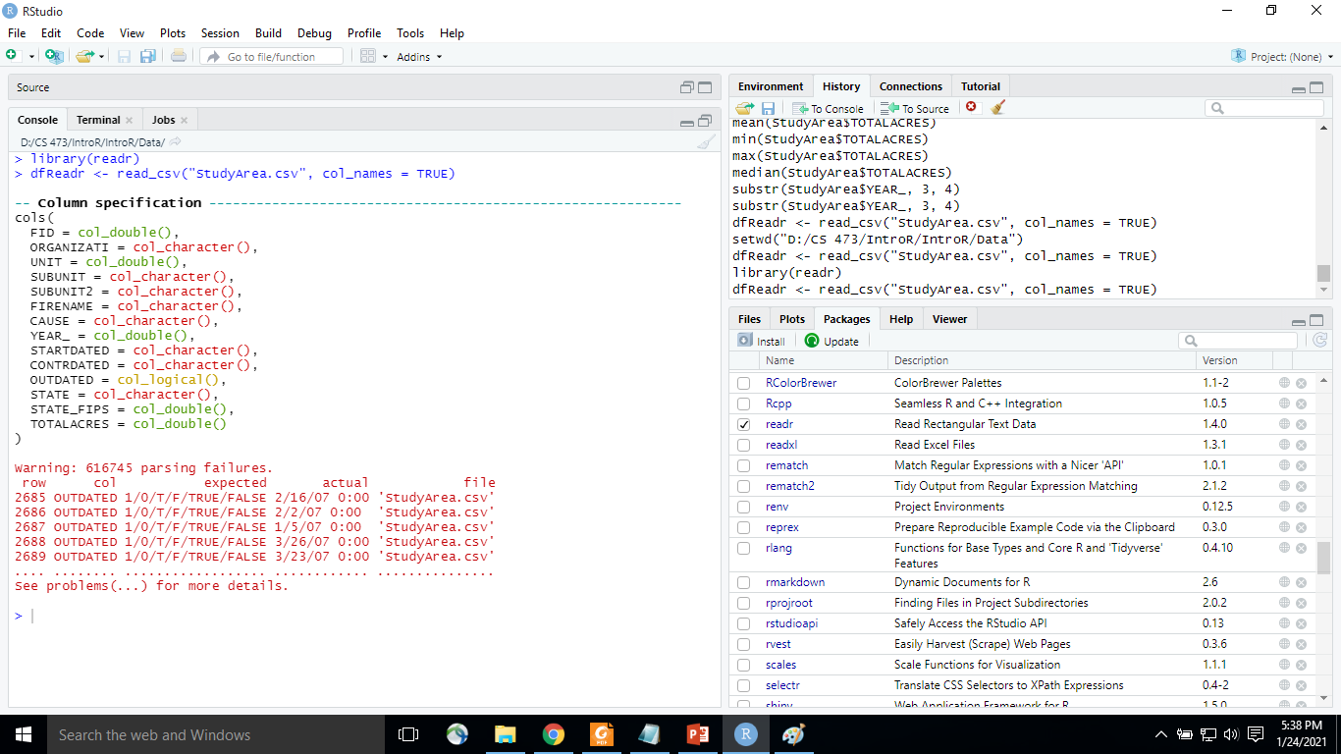
Exercise 4: Using readr to load data
dfReadr <- read_csv("StudyArea.csv", col_names = TRUE)
problems(dfReadr) # to get the list of parsing errors

Slide 12
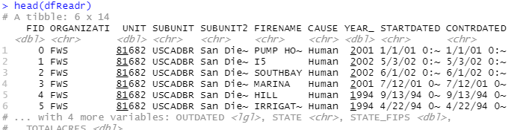
Exercise 4: Using readr to load data
dfReadr = read_csv(“StudyArea.csv”, col_types = list(UNIT = col_ character()), col_names = TRUE) # to resolve unit column issue because it contains both numeric and char
head(dfReadr)

Slide 13
Exercise 4: Conclusion
In this chapter you learned various functions for loading an external data file including the built in R functions read.table() and read.csv(). While these functions can certainly get the job done, the read_csv() function found in the readr package is a much more efficient function for loading external data.

